Slide 1

1.$Divide$
$$\left(x^{3}+3x^{2}−28x−62\right)÷\left(x+6\right)$$
A. Go to 4
B. Go to 7
Go to 8

Slide 2
2. Find the remainder after dividing.
$$\left(x^{3}−14x+8\right)÷\left(x+4\right)$$
A. 0 Go to 5
B. 16 Go to 10
-16 Go to 9
4 Go to 3

Slide 3
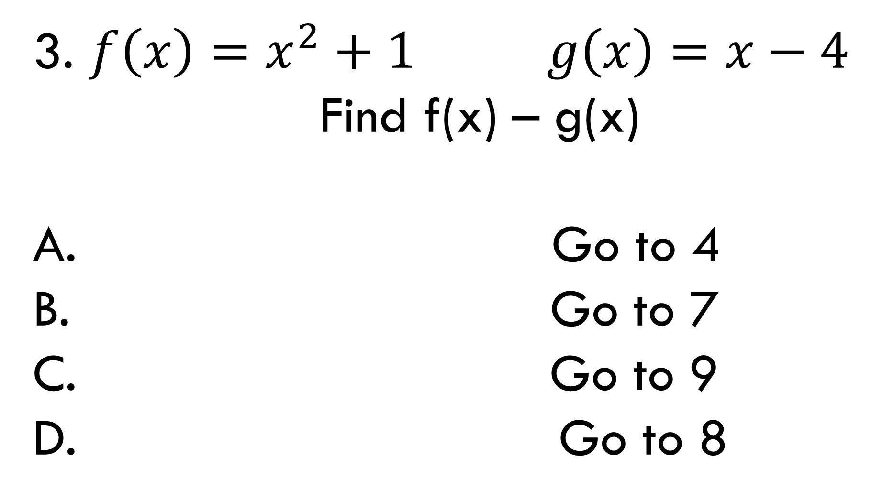
3. $f\left(x\right)=x^{2}+1 g\left(x\right)=x−4$
Find f(x) – g(x)
A. Go to 4
B. Go to 7
Go to 9
Go to 8

Slide 4
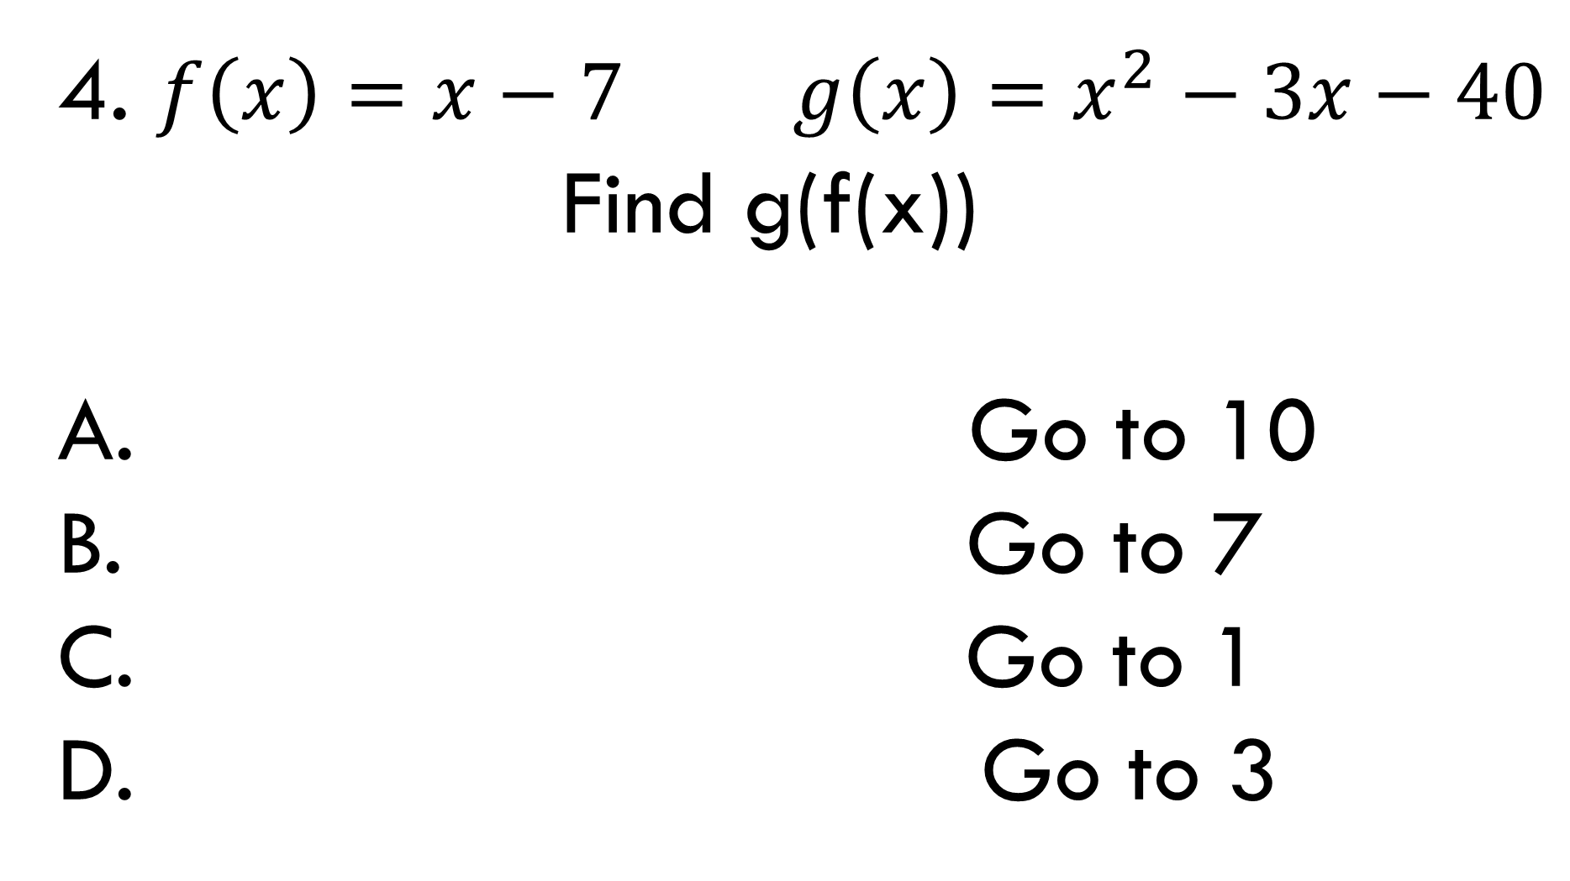
4. $f\left(x\right)=x−7 g\left(x\right)=x^{2}−3x−40$
Find g(f(x))
A. Go to 10
B. Go to 7
Go to 1
Go to 3

Slide 5
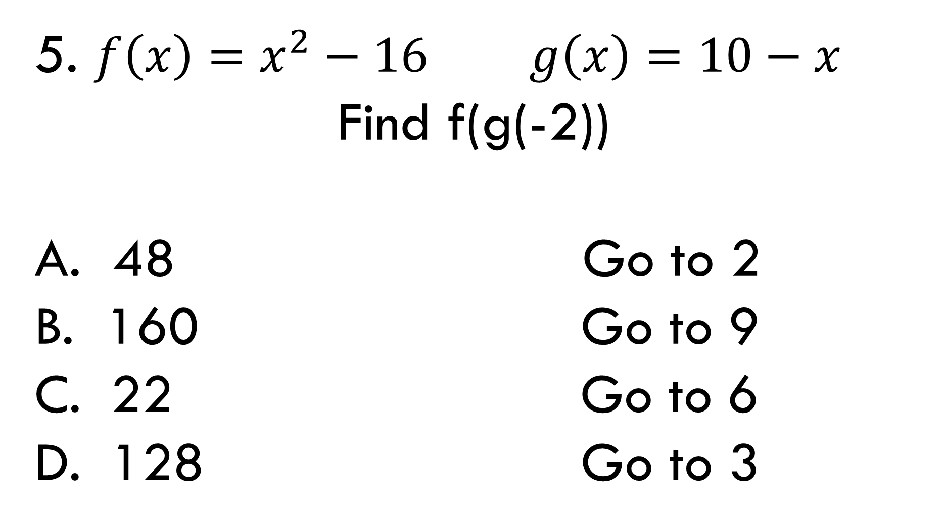
5. $f\left(x\right)=x^{2}−16 g\left(x\right)=10−x$
Find f(g(-2))
A. 48 Go to 2
B. 160 Go to 9
22 Go to 6
128 Go to 3

Slide 6
6. Use Pascal’s Triangle to find the
coefficient of the $x^{3}$ term of: ${ (3x+1)}^{5}$
A. 2025 Go to 5
B. 270 Go to 1
11250 Go to 7
243 Go to 10

Slide 7
7. Use Pascal’s Triangle to expand: ${ (2+3i)}^{3}$
A. -62 – 63i Go to 8
B. 46 – 9i Go to 6
62 +63i Go to 2
-46+9i Go to 10

Slide 8
8. Find the inverse of y = 2x – 7
A. $y=\frac{x−7}{2}$ Go to 7
B. $y=7x+2$ Go to 3
$y=\frac{x+7}{2}$ Go to 4
$y=\frac{7}{2}x$ Go to 9

Slide 9
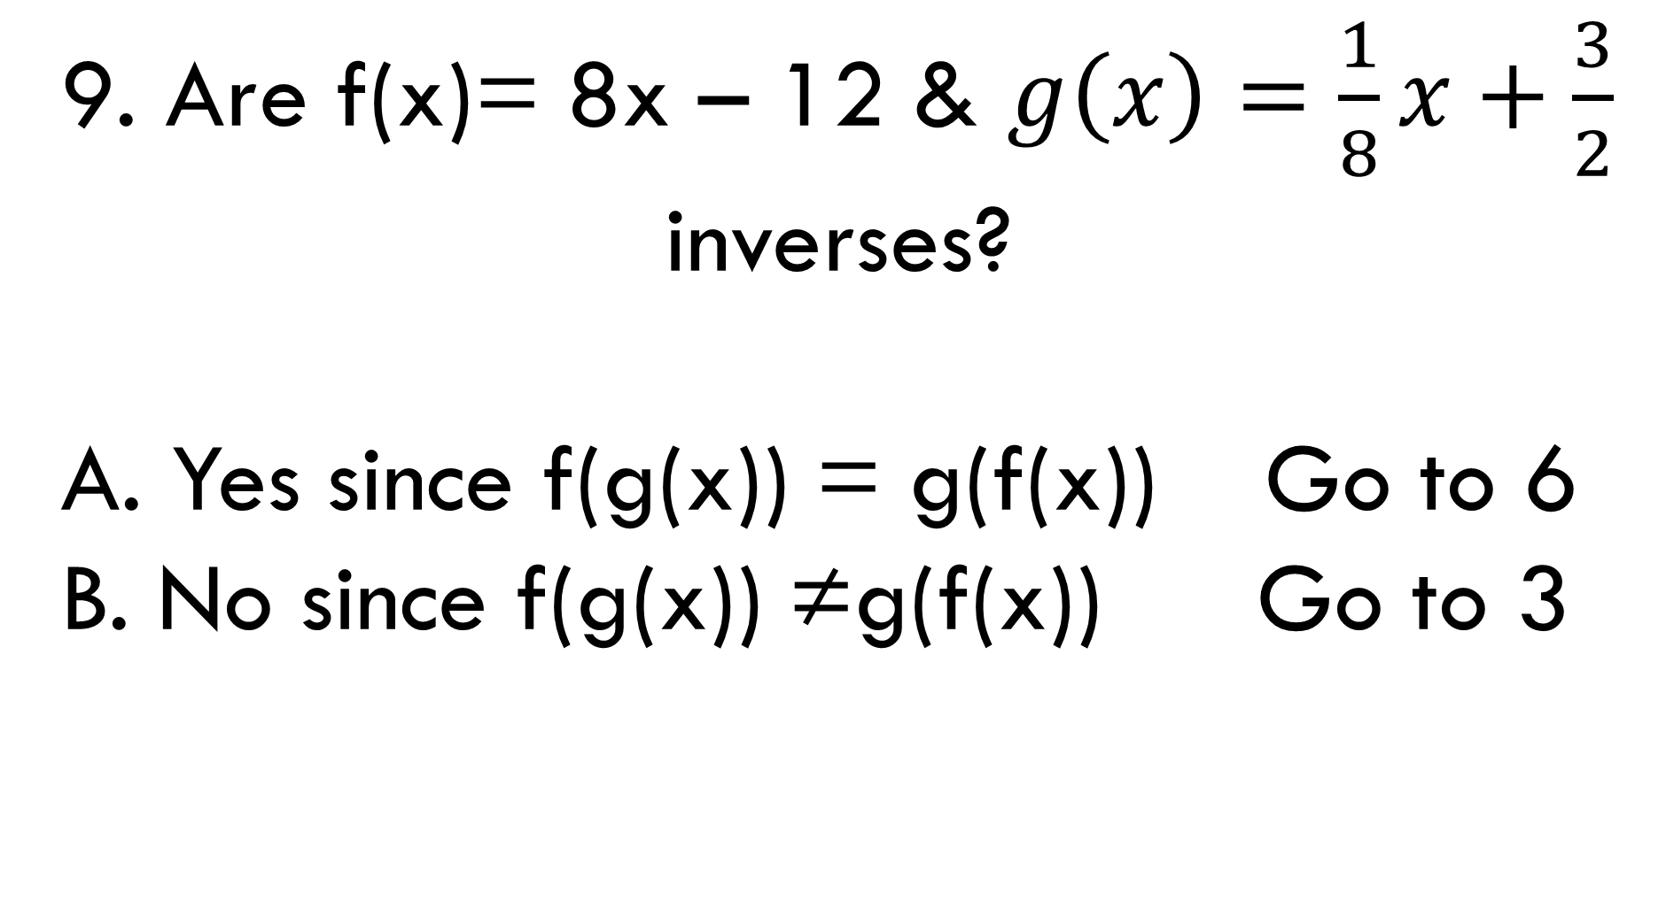
9. Are f(x)= 8x – 12 & $g\left(x\right)=\frac{1}{8}x+\frac{3}{2}$
inverses?
A. Yes since f(g(x)) = g(f(x)) Go to 6
B. No since f(g(x)) ≠g(f(x)) Go to 3

Slide 10
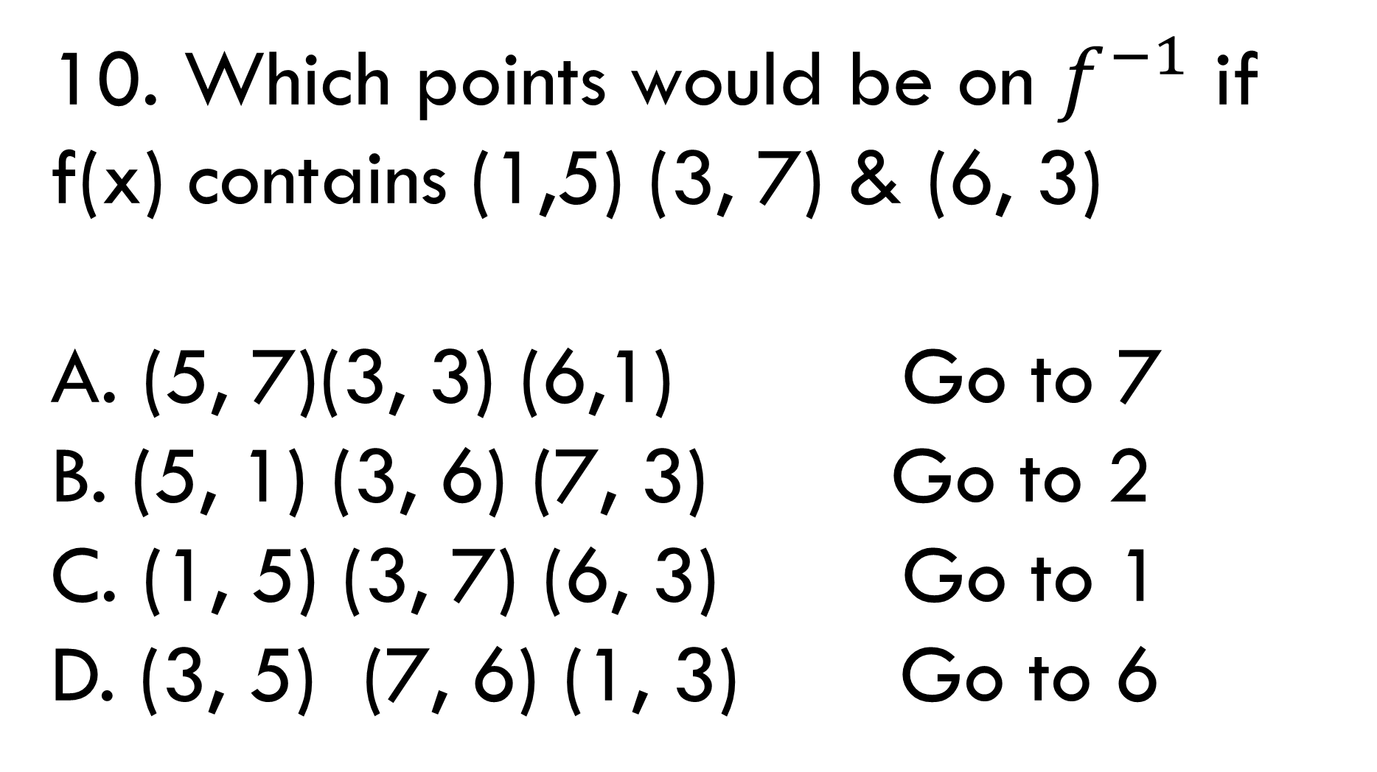
10. Which points would be on $f^{−1}$ if f(x) contains (1,5) (3, 7) & (6, 3)
A. (5, 7)(3, 3) (6,1) Go to 7
B. (5, 1) (3, 6) (7, 3) Go to 2
C. (1, 5) (3, 7) (6, 3) Go to 1
D. (3, 5) (7, 6) (1, 3) Go to 6

Slide 11
Answers:
1. C 7. D
2. A 8. C
3. C 9. A
4. B 10. B
5. D
6. B

